Slide 1
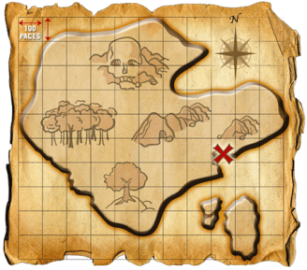
Treasure Map
Finding the hidden gems in music.
By Andy Huang and Mike Murphy

Slide 2
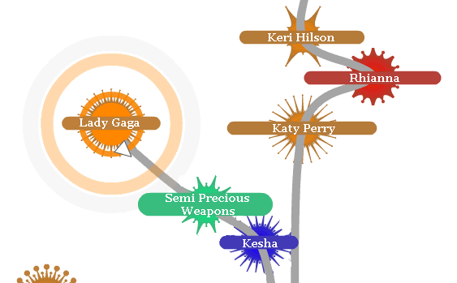
Form
Visual UI with a focus on simplicity and creativity.

Slide 3
Function
Discover new songs in a physics based Javascript.
Bubbles link and appear based on various qualities – such as a larger bubble will appear for more popular artists,
Clicking on a bubble to find other bubbles similar to that artist.
Intuitive Controls.

Slide 4
Future
http://9elements.com/io/projects/html5/canvas/
http://localhost:3000/home/

